Slide 1
Get-Contributing
Contributing to community resources
Simon Wåhlin (@SimonWahlin)

Slide 2
Agenda
Git(Hub) concept
Git Commandline
Demo
Contributing to an open source project

Slide 3


Fork
GitHub
Upstream
Pull Request
Origin
Pull Upstream
Clone
Pull
Push
Change
Client
Local
Commit
Add

Slide 4
Git commandline
D:\Repo [Issue#1 +1 ~0 -0]>git status
D:\Repo [Issue#1 +1 ~0 -0]>git add <file>
D:\Repo [Issue#1 +1 ~0 -0]>git commit –m $MSG
D:\Repo [Issue#1]>

Slide 5
Demo
Contributing to a project

Slide 6
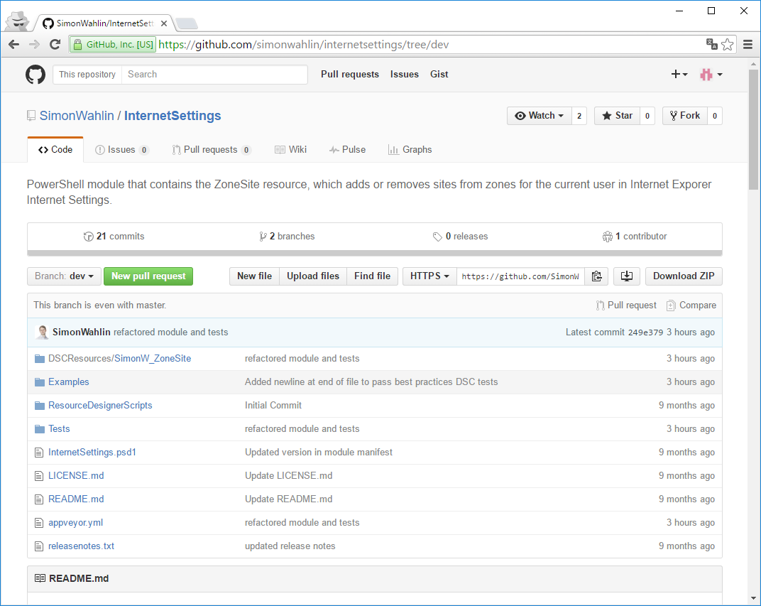

Slide 7
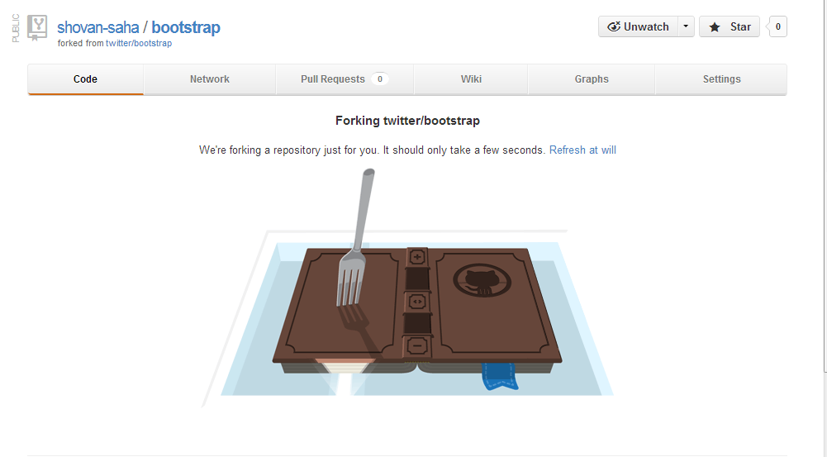

Forking SimonWahlin/InternetSettings

Slide 8
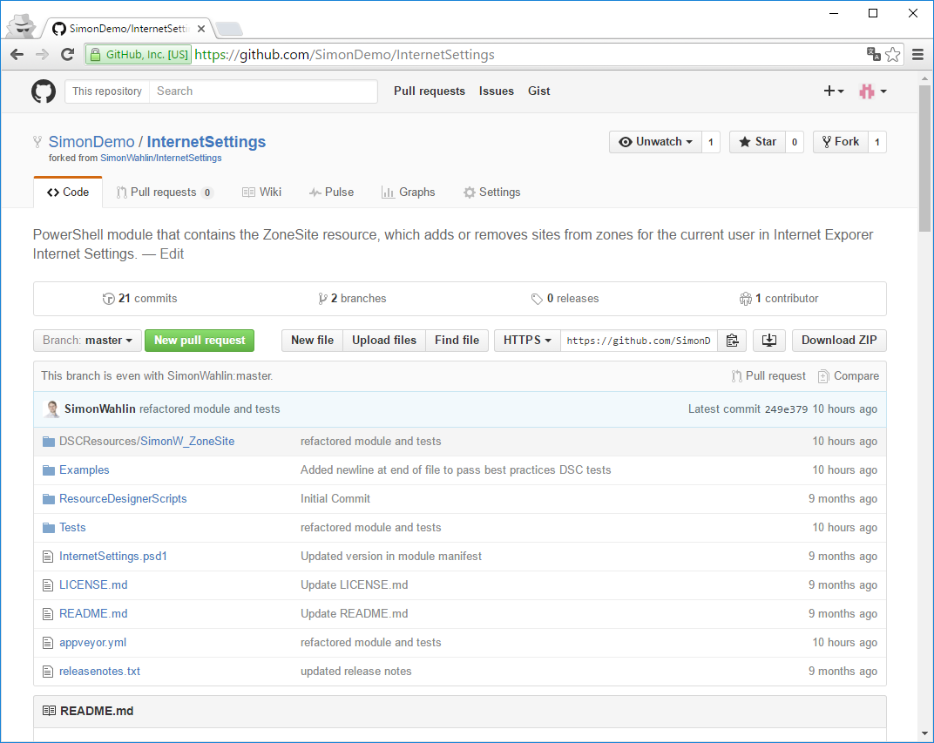

Slide 9
Add a remote
D:\Repo [master]>git remote add upstream $Uri
D:\Repo [master]>git remote -v
D:\Repo [master]>git pull upstream master

Slide 10
branch – edit - commit
D:\Repo [master]>git checkout –b SiteType
D:\Repo [SiteType]> ise
D:\Repo [SiteType +0 ~1 -0]>git add file.ps1
D:\Repo [SiteType +0 ~1 -0]>git commit –m $MSG
D:\Repo [SiteType]>git push
git push --set-upstream origin SiteType

Slide 11
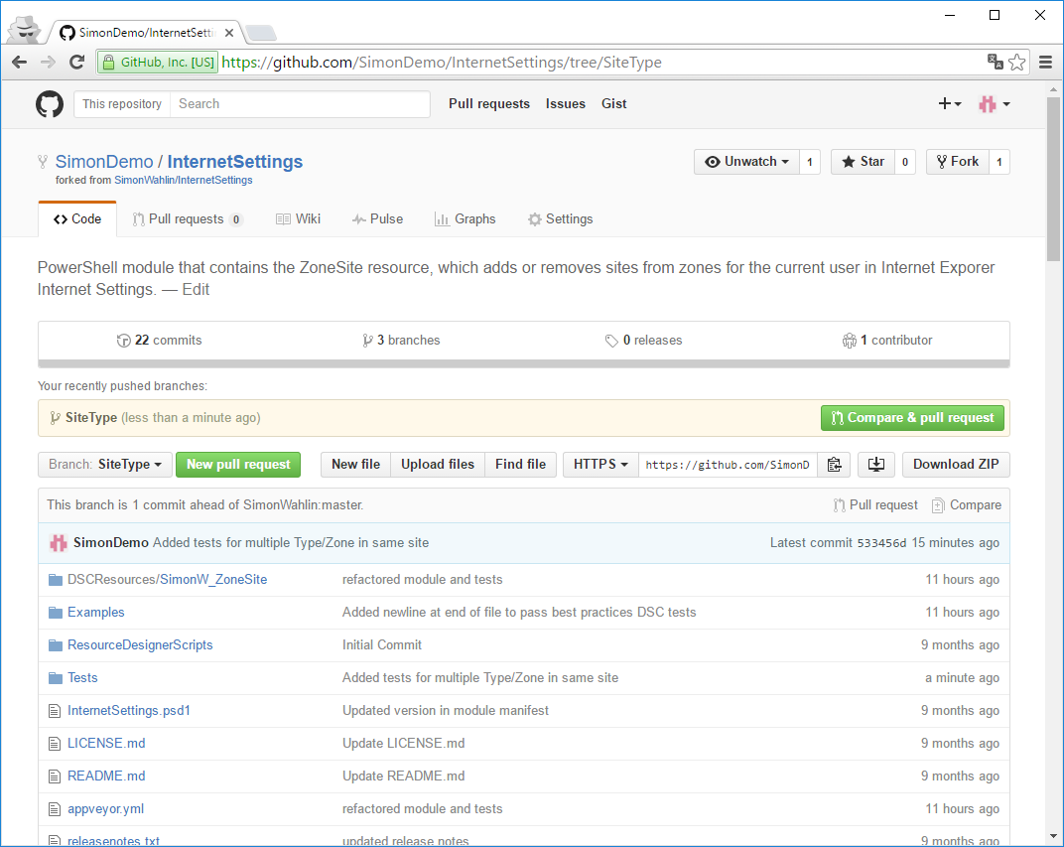

Slide 12
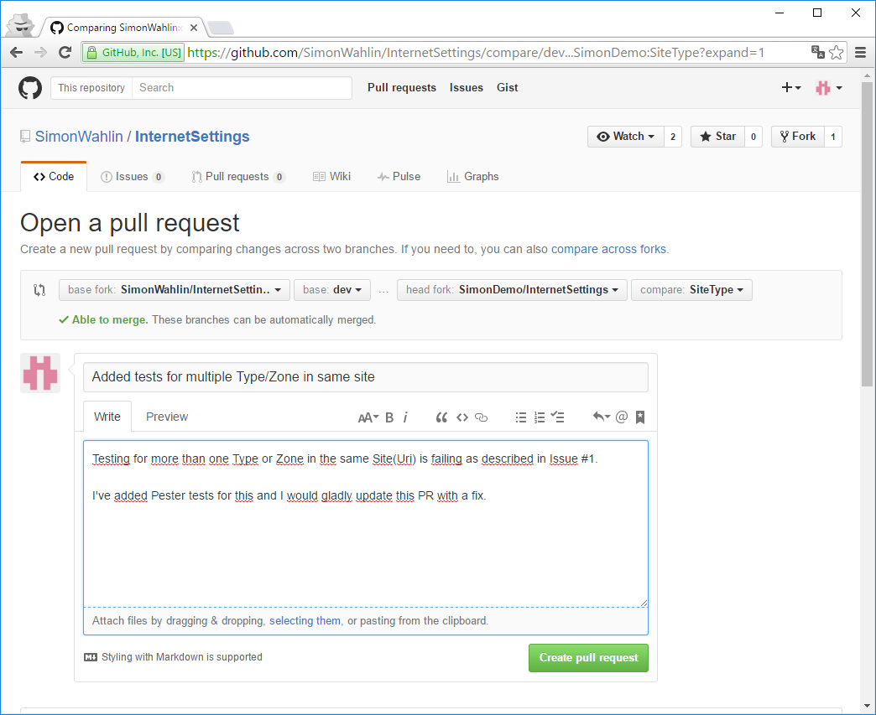

Slide 13
Questions?

Slide 14
Summary
Ask to help
Follow guidelines
Change as little as possible
Use dedicated source branch

Slide 15
Next Steps...
Now: 15 min break
Grab a coffee
Stay here to enjoy next presentation
Change track and switch to another room
Ask me questions or meet me in a breakout session room afterwards

Slide 16

@{
Name = 'Simon Wåhlin'
Company = 'Advania - Knowledge Factory'
Contact = @{
Blog = 'blog.simonw.se'
Twitter = '@SimonWahlin'
GitHub = 'SimonWahlin'
}
Other = @(
'Microsoft Certified Trainer',
'Verified Effective Toolmaker',
'PowerShell Hero'
)
}

